Slide 1

Humanize Your Digital Experience
with Conversational AI
CHAT BOT

Slide 2
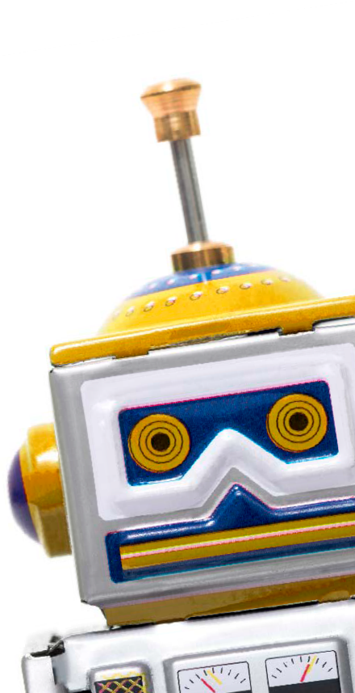

Bot automation is estimated to save businesses $8 billion a year by 2022.⁵
Chat Bots are playing an increased role in the customer journey
Welcoming and onboarding – From the moment someone visits your site, logs onto your app, or connects with your social media page, a bot can be there to start the conversation.
57%
of consumers are interested in getting real-time answers from bots⁴
Personalized guidance – Help customers get where they need to go, based on feedback, browsing history, and other variables. Bots can continually learn from interactions and use the information to get better at helping consumers (and agents).
_{47%}
Improving future CX – Monitor conversations in real time and analyze available data to personalize product recommendations.
would buy items suggested from a bot⁴
Service and support – Provide basic tech support, system status checks, open support tickets, answer questions, collect feedback, and point customers toward helpful resources quickly and efficiently.
Notes:
Chat Bots are playing an increased role in the customer journey, enabling businesses to be more accessible 24/7, and to connect in a more human, conversational way.
4 “Artificial Intelligence Is Here - People Just Don’t Realize It,” Mimi An, Hubspot blog.
5 “Chatbot Conversations to deliver $8 billion in Cost savings by 2022,” Juniper Research blog, July 24, 2017.

Slide 3

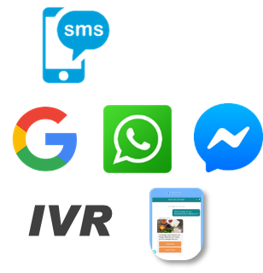
Chat Bot – A Differentiator in Conversation AI Space
Human like
Conversational AI
Simulates & processes text or spoken conversation
Domain & Channel
Agnostic
Agent Training with
Trainer bot
Ubiquitous(24x7)
Anytime/Anywhere access
Multilingual Support
e.g, English Arabic
2- way & Synchronous
What we provide (All inclusive)
Identify optimal use cases. Design, develop and optimize bots using CNX proprietary NLP & 3rd party
Provide, manage and support chat bot platform software
Complete live agent services as needed to achieve business outcomes, SLAs
Reports and insights on KPIs, interactions, volumes, utilization & more
Use pre-built API’s and integrations
SOCIAL, MOBILE & WEB CHANNELS
PLATFORM
LIVE AGENTS
REPORTING
BOTS
CONSULTING
APPLICATION SERVICES
SUPPORT & MAINTEANCE
QUALITY ASSURANCE

Slide 4
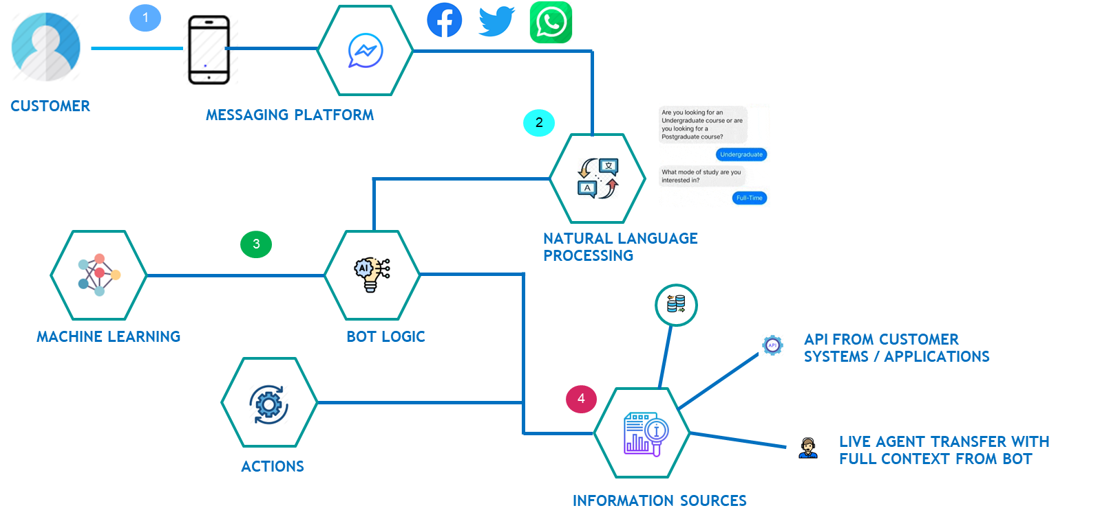
How it works
Customer shall use any of the channels of their choice(fb, twitter, web, mobile)
1
Concentrix Chatbot analysis customer request using proprietary NLP engine & performs Real time Language Translation to serve customers in local language
2
3
Bot Logic using Machine Learning Algorithms
(Supervised - Text Classifier, SVM)
4
Integrations with Clients Systems/Apps for real time data exchange (REST/SOAP API)
5
Transfer to live agents alongside context of Chat Bot conversational history being available to agents

Slide 5
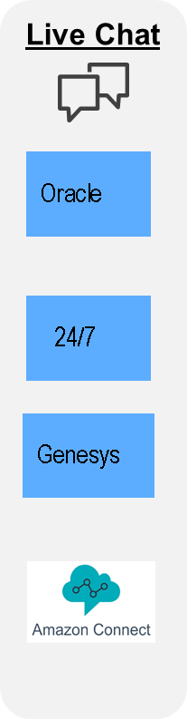



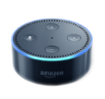

Solution highlights
SaaS/Cloud-based
Proprietary NLP (built in-house)
100+ languages including double byte languages (e.g., Chinese, Japanese)
Annual subscription price based on # of monthly conversations
A conversation can be one or multiple chats between the bot and the customer
Minimum term: 12 months
Channels & Natural Language Processing
Channels
NLP
NLP
Proprietary NLP
Google
Dialog Flow
IBM Watson
MS Luis
Languages Supported : French, German, Spanish, Italian. Korean, Arabic, Chinese, Japanese, Hindi. Polish, Portuguese Russian, Swedish & much more ..
Rasa
Supported Geos - Global

Slide 6



Chat Bot : Key Features | Benefits | Metrices
FEATURES
BENEFITS
MULTI-INTENT
INCREASED FCR
LOWER
COST TO SERVE
REDUCED
CUSTOMER EFFORT
INTELLIGENT KNOWLEDGE BASE
IMPROVED
CSAT / NPS
PERSONALIZED
UX
IMPROVED CUSTOMER
ENGAGEMENT
PII MASKED/ ENCRYPTED
ENHANCED SECURITY
IMPROVED QUALITY
REDUCED AGENT EFFORT
SENTIMENT ANALYSIS
POWERFUL INTEGRATIONS
METRICES
QA & EVALUATION
40% Decrease in AHT
42% FCR improvements
65% increase
in Self-service
20% increase
conversion rate
SOCIAL CHANNELS SUPPORT
35% Reduction in Time to Market
25% Savings in repetitive calls
85% increase
In agent quality
88% Customer Enquiries Resolution
ESCALATION TO SUPERVISOR

Slide 7
Future Releases
Time Frame Q2
Time Frame Q3
Time Frame Q4
Sentiment & Emotional analysis
Quality analysis & Evaluation
Customer Information for Live Chat
Upload/Click photos
Data masking at chat server storage
Queue management system
Random answers for the intent
Response as per sentiment
Recommendation for incorrect spellings
Bot Integration with Facebook Messenger
OTP Verification
Responsive Chat Widget
OCR for image data validation at runtime
Broadcasting Messages
Offline message handling
Escalation chat with supervisor transfer (group chat)
Bot Integration with WhatsApp
Bot Integration with Telegram
Multi message response

Slide 8

Why Concentrix – Value Proposition
Domain experts
Time to market
Build once deploy everywhere
All inclusive
Proprietary NLP
Best in class AI Partner Support
Outcomes focused
Notes:
Domain experts – Know the best uses that deliver impact
Speed to market – Proven methods, pre-built blueprints
Build once deploy everywhere – mobile, web, social
All inclusive – Agents, technology, automation
Business outcomes - Outcomes-based delivery built for your needs at any scale
Speed to market – Build bots quickly and improve digital engagement with visual design tools, pre-built bot blueprints, APIs, and SDKs
Boost business results – We are domain experts and can help identify the best use cases, design and deploy chatbots, and then enabling them to become smarter as things change
Reduce human intervention – use bots to automate tasks across the customer journey, reducing dependency on human staff or agents
Lower costs – lower service costs by completing more complex interactions and tasks in digital self service
Engage multiple channels 24/7 – build once deploy everywhere enables customers across all preferred channels
Increase loyalty and service stickiness – create consistent brand experiences across channels and use cases

Slide 9
Case Study

Slide 10



Leading American life insurance Company
20-25% call volumes rerouted
Our client was experiencing a high volume of calls and was concerned over the increase in AHT, with customers feeling hassled by registration and security process before even getting to their request, and an emphasis on reducing AHT actually caused error rates to rise.
As a result, the client wanted to route more volumes and expand the contact center, but did not want to incur higher costs in order to do so.
Concentrix designed and implemented a Chatbot to automate responses using our Cognitive Automation platform and automated supporting activities such as registration processes, billing & payment, policy & personal detail updates, and new policy loans.
The Cognitive AI solution enabled customers to interact with a specialist (live Chat agent) to help them on a real time basis and provide resolution post-Bot interaction.
to chat bot & Livechat Agent with reduction of staff or cost.
Depletion in Calls
As most of the FCR are met either by ChatBot or LiveChat
Reduction in Error Rate
well below target and, in fact, virtually eliminated
Insurance
Concentrix Cognitive Automation Implementation
Cognitive ChatBOT
Business Challenges
Concentrix
Solution
Results

Slide 12
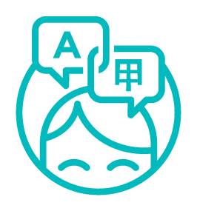





Multi-Lingual Chat : How it works?
Key features
Machine-Human collaboration for faster and effective translation
AI-powered, human-refined translation ensures chats sound like a native in every language
Agent validation of machine translation when confidence score is below defined threshold
180+ Language pair supported
< 95%
< 95%
< 95%
Global Customer
e.g FR/DE/SP
Channel Chat/Messaging
Translation Engine
Channel Chat/Messaging
Universal Agent
e.g English
Removes language as a job requirement
Live chat support with real time language translation
Solve seasonal peaks and increase overall operational agility
*Customized human intervention threshold

